Slide 1
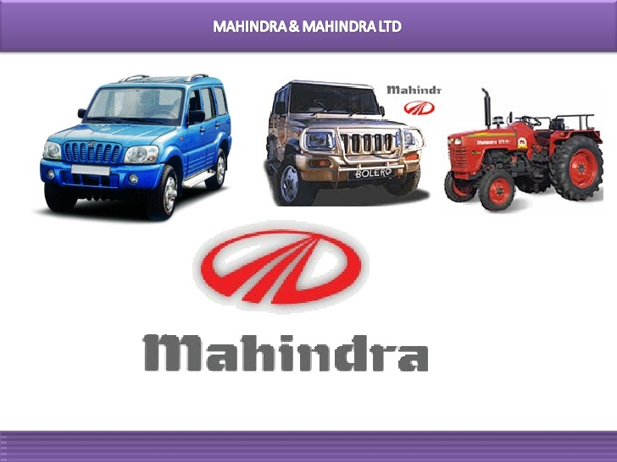
DR. SRINIBASH DASH
Associate professor & Head
School of Management
SBP,GMU

Slide 2


Regarding M&M
M&M is an Indian multinational automaker.
It is one of the largest automobile manufacturers by production.
The company was founded in 1945 in Ludhiana as Mahindra & Mohammed by brothers K.C. Mahindra and J.C. Mahindra and Malik Ghulam Mohammed.
After India gained independence and Pakistan was formed, Mohammed emigrated to Pakistan.

Slide 3

Cont….
The company changed its name to Mahindra & Mahindra in 1948.
M&M’s operations span across 79 countries through out the world.
The company operates through over 100 subsidiaries, associate companies, and joint ventures spread across India and overseas markets mainly in the UAE, the UK, China, the US, Germany, and Singapore

Slide 4

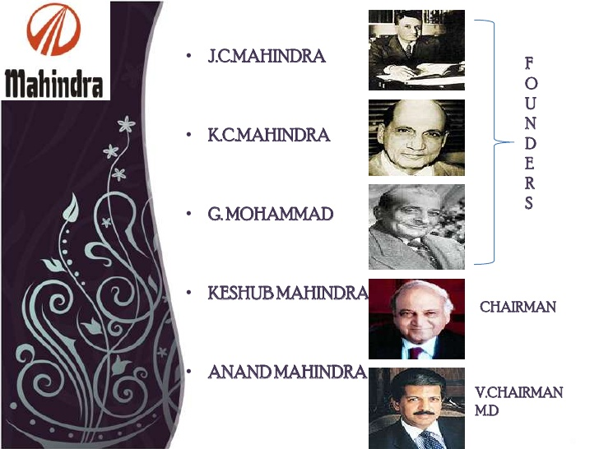
TOP MANAGEMENT
J c Mahindra
FOUNDERS
K c Mahindra
G Mohammad
Keshub Mahindra
CHAIRMAN
Anand mahindra
V.Chairman
MD

Slide 5

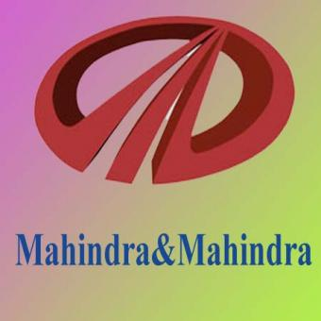
HISTORY
M&M was set up as a steel trading company in 1945.
In 1947, it expanded into manufacturing general-purpose utility vehicles, starting with assembly under license of the iconic Willys Jeep in India.
Soon established as the Jeep manufacturers of India, M&M later branched out into the manufacture of light commercial vehicles (LCVs) and agricultural tractors.
M&M is the leader in the utility vehicle segment in India with its flagship UV Scorpio and enjoys a growing global market presence in both the automotive and tractor businesses.
Over the past few years, M&M has expanded into new industries and geographies.
They entered into the two-wheeler segment by taking over Kinetic Motors in India.
The US based Reputation Institute recently ranked Mahindra among the top 10 Indian companies in its 'Global 200: The World's Best Corporate Reputations' list.

Slide 6
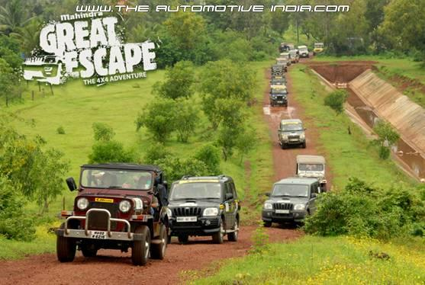
PRODUCTS & SERVICES
Farm Equipments
Defense
Utility
Two wheeler
GOODS VEHICLE

Slide 7
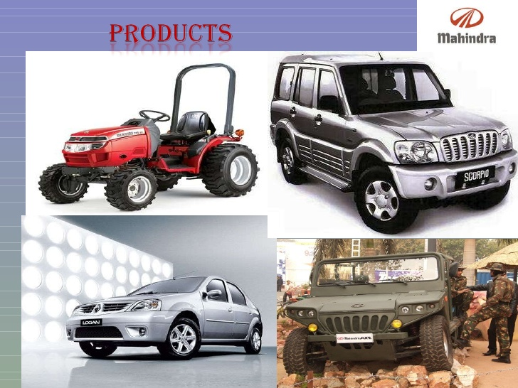
Farm
Defense

Slide 8
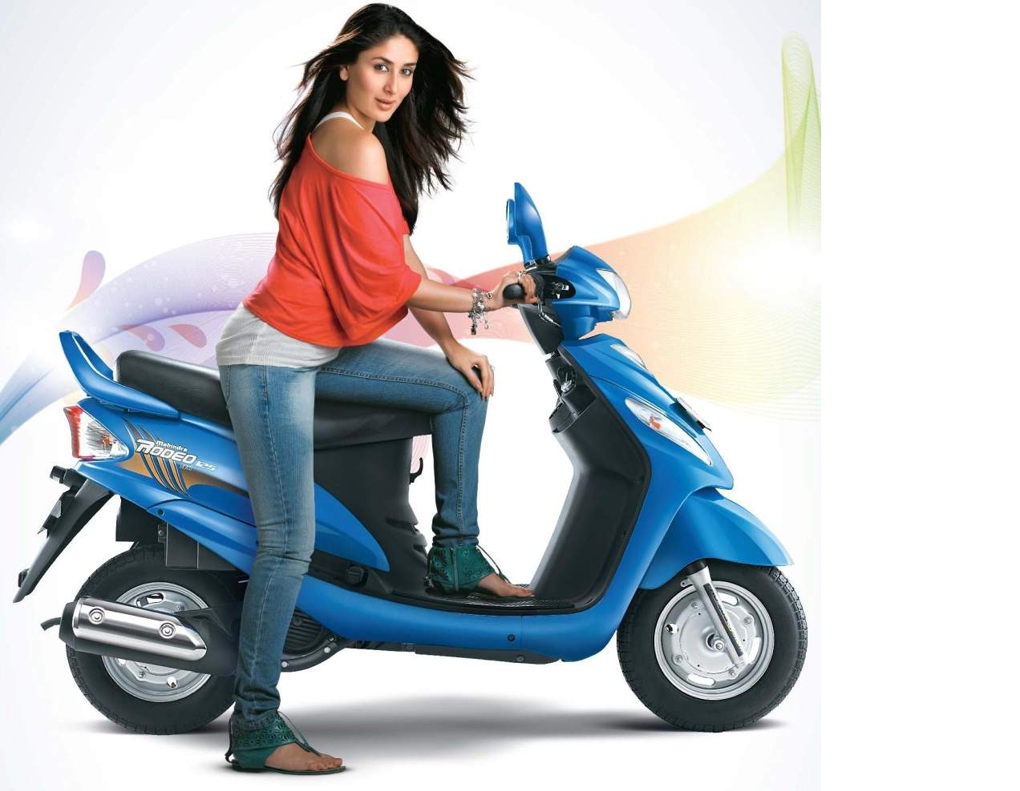
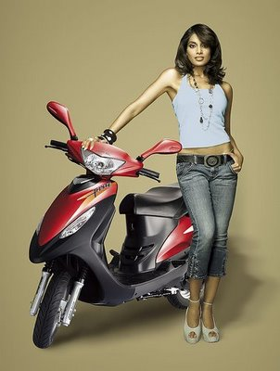
Two wheeler

Slide 9

MAJOR CLIENTS
Indian Army
State government departments
Transporting Companies
Travel Operators
Fruit & Vegetable traders
Indian Public

Slide 10

MANUFACTURING FACILITY
KANDIVLI
NASIK
ZAHEEERABAD
IGATPURI
HARIDWAR

Slide 11
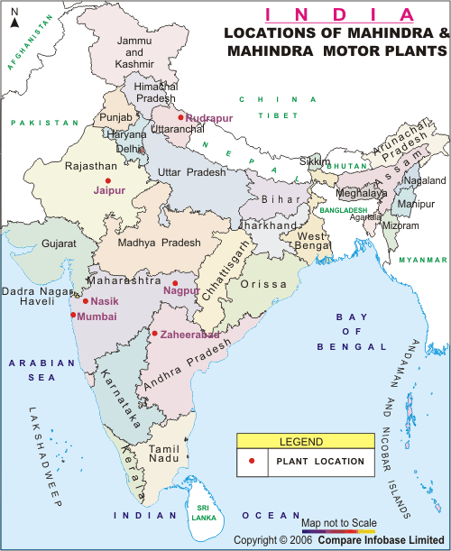
Manufacturing Facilities

Slide 12

MISSION
To create India’s largest automobile and automobile related products distribution network by providing dealers and customers with the largest choice of unique world class products and services.

Slide 13
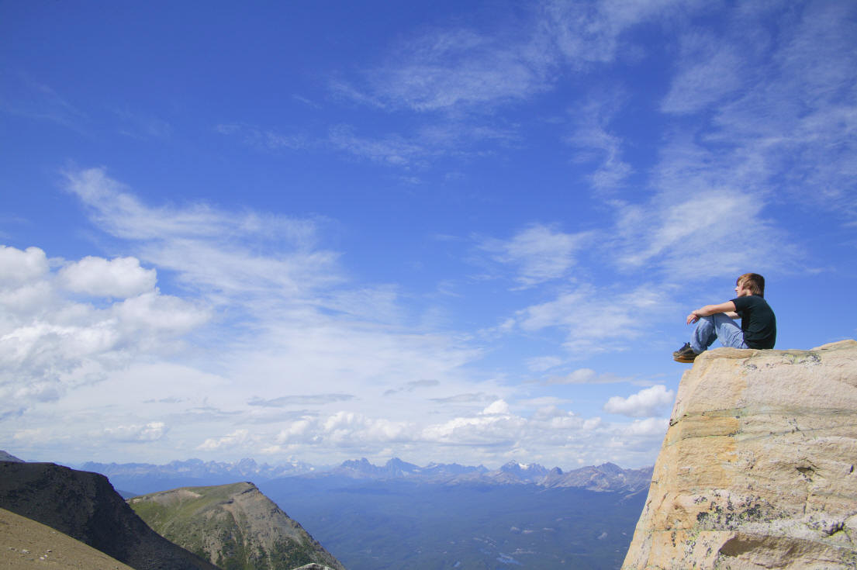
VISION
To create a fully collaborative environment in which suppliers can deliver exactly what the company needs, when it needs it, and a competitive cost.

Slide 14

OBJECTIVE
Customer happiness is the chief objective of M&M
Customer first
Mahindra says :
We exist and prosper only because of the customer. We will respond to the changing needs and expectations of our customers speedily, courteously and effectively.

Slide 15
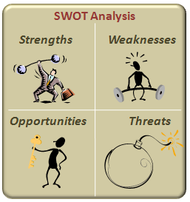

Slide 16

STRENGTH
Mahindra has been one of the strongest brands in the Indian automobile market
Excellent branding and advertising, and low after sales service cost
Diversified Business Operations
Focused Research and Development Efforts
Strong Equity and Liquidity Position

Slide 17
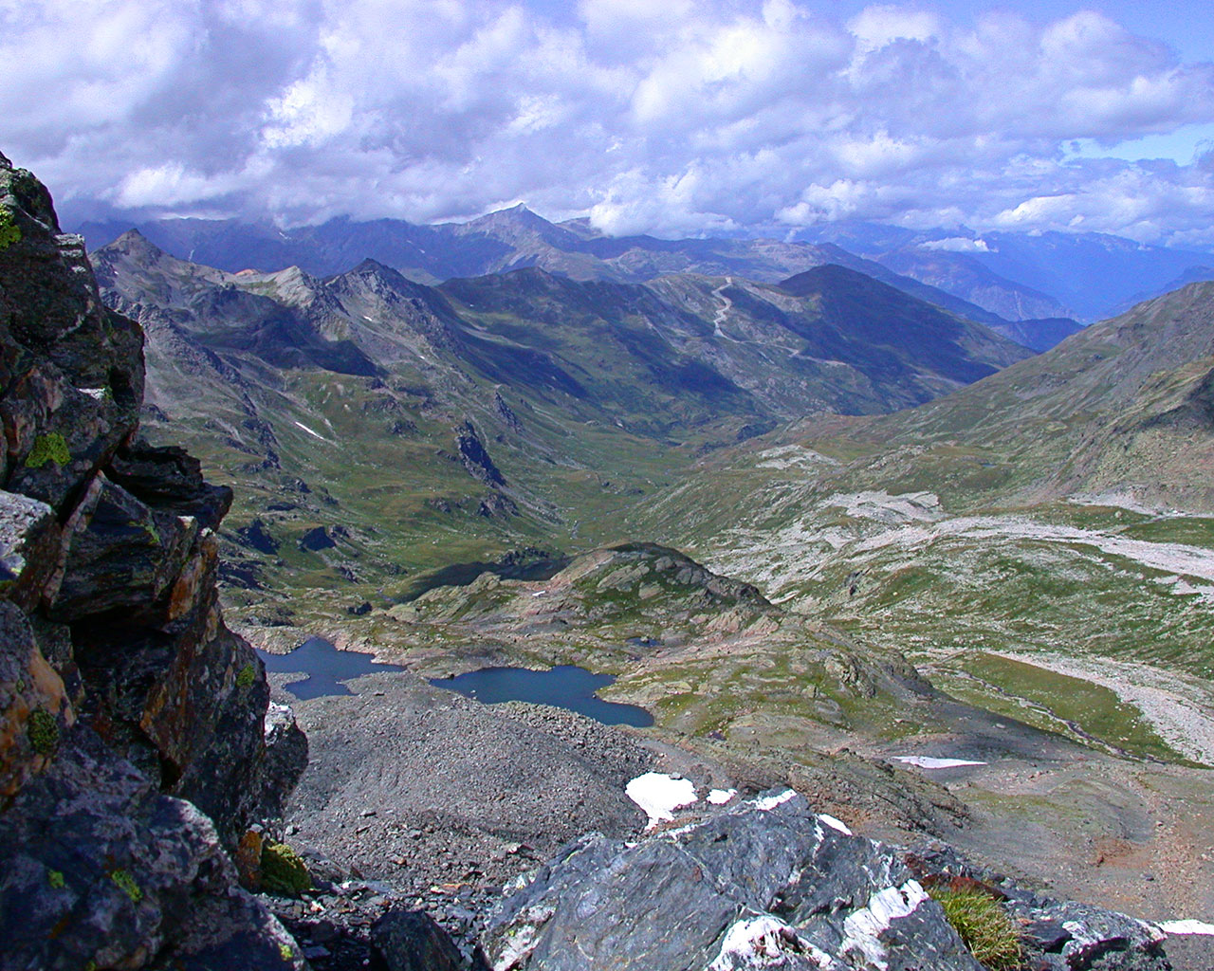
Weakness
Mahindra’s partnership with Renault did not live up to international quality standards through their brand Logan
Pending Legal Proceedings
The company is highly dependent on rural sector

Slide 18

Opportunity
Developing hybrid cars and fuel efficient cars for the future
Tapping emerging markets across the world and building a global brand
Fast growing automobile market
Growing in the market through electric car Reva (controlling stake) and entry into two-wheeler segments
Growth in Indian Automotive Sector
Strategic Agreements
Expansion Initiatives

Slide 19
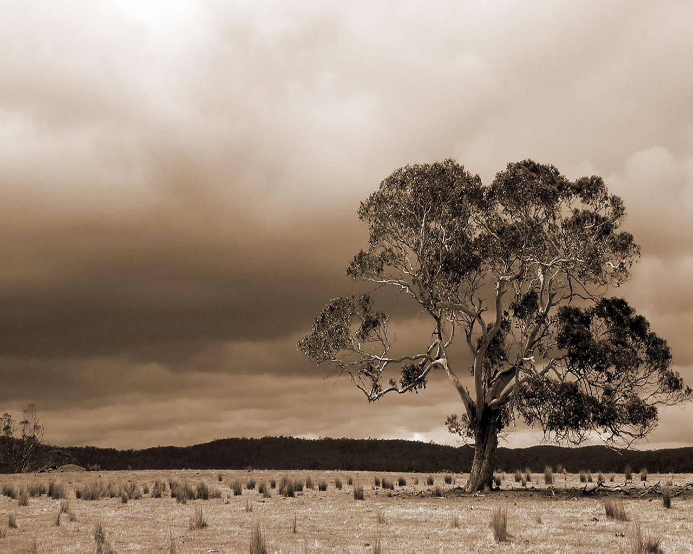
Threat
Government policies for the automobile sector across the world
Ever increasing fuel prices
Intense competition from global automobile brands
Substitute modes of public transport like buses, metro trains etc
Fluctuating Raw Material Prices
Stiff Competition

Slide 20



